Slide 1
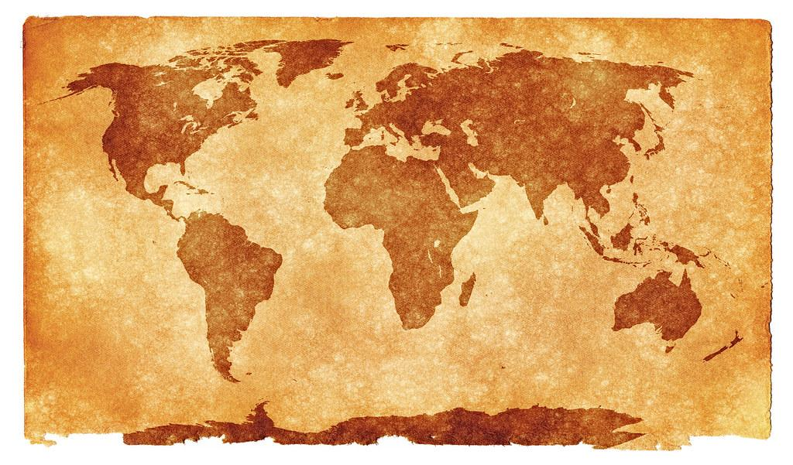
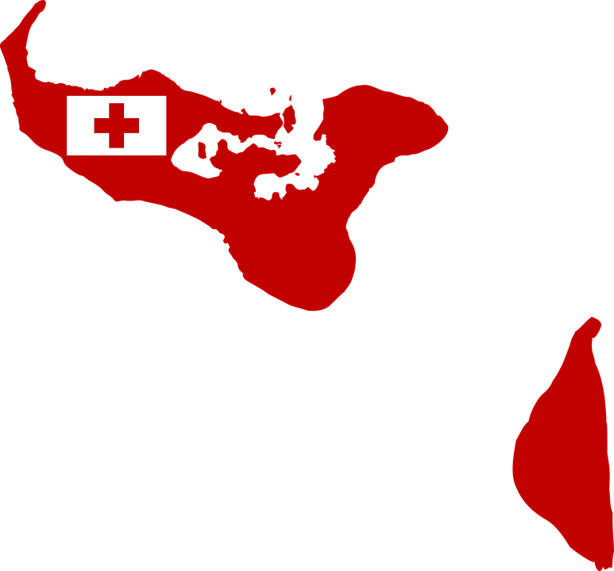
Our Commonwealth country is Tonga
Kia ora my name is Aaleah and this is my partner Yun and today we are going to talk about what country we researched for the Commonwealth Games country snapshot

Slide 2
HOW MANY MEDALS HAS TONGA WON.
Tonga has only won 1 silver medal from the Commonwealth Games and has not gotten a single bronze or gold medal

Slide 3
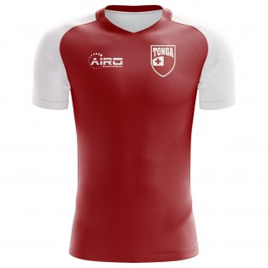
This is the game kit for Tonga and it has a little tongan flag on the side of it for representing their country

Slide 4
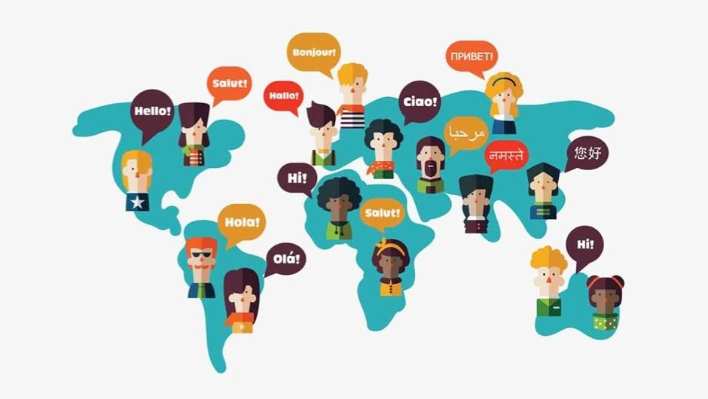
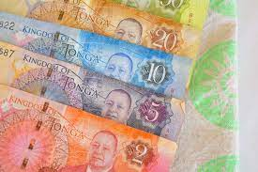
The size of population in Tonga is:
106,856.
The currency used in Tonga is called
Pa’anga.
Language(s):
Tongan, German.

Slide 5
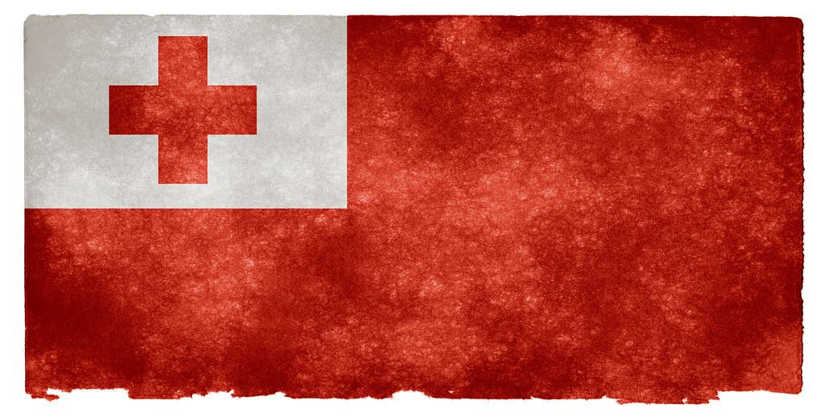
THE TONGA FLAG.
Here is the Tongan flag and it was created by Shirley Waldermar Baker being adopted by the new king in 1875
Notes:
Shirley Waldemar Baker

Slide 6
The Commonwealth games history
Tonga made their debut in the 1974 Games in Christchurch, New Zealand. Their first medal came at the 1994 Games in Victoria when Paea Wolfgramm took home a weightlifting bronze. He then went onto win a silver medal at the Atlanta Commonwealth Games in 1996. At the 2010 Games in Delhi, Tonga won 1 silver medal.

Slide 7
THE FACTS ABOUT TONGA
Tonga is made up of around 170 islands, split into five administrative divisions. One of which is The Niuas, a group of three islands located approximately 300km (186 miles) north of the nearest Tongan island group, Vava’u. In fact, The Niuas are closer to Samoa than Vava’u, which especially reflects in the locals of Niuafo’ou, who speak their own Tongan dialect with some influences from Samoa. Learn more about The Niuas in The Complete Guide to The Niuas.
The holiday starts on january the 9th which is tonga’s national holiday and ends on november 4th

Slide 8
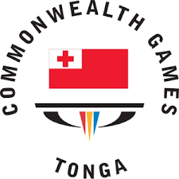
NATIONAL ANTHEM: Koe Otua Mafimafi Fakafetai.
Successful athletes.
Will hopoate .
Daniel tupou.
Kotani stagg’s.
Isileli folau.
Salesi piutau.
Siua maile.
Notes:
They are kf

Slide 9
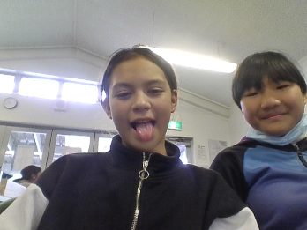
THANK YOU
Thank you for looking at me and my partner slide i hope you enjoyed it have a great day.

